Slide 1
Architectural Innovation: The Reconfiguration of Existing Product Technologies and the Failure of Established Firms
Rebecca M. Henderson and Kim B. Clark
1990
Administrative Science Quarterly, 1990
Special Issue: Technology, Organizations, and Innovation
Revised by Bryn Choi, Spring 2023
Prepared by Deepika Chhillar, Spring 2021

Slide 2
Research Objective
Develop and apply a model that explains how minor innovations can have great competitive consequences.
Why do minor innovations in technological products hold the potential to have disastrous effects on industry incumbents?

Slide 3
A framework for defining Innovation
The Henderson-Clark Innovation Model proposes four categories of innovation.
These categories are based on whether the innovation relates to a product’s architecture, components or both.
When both are low, “incremental innovation” occurs and when both are high, ”radical innovation” occur.
Suggests that a given innovation may be less radical or more architectural, not to suggest that the world can be neatly divided into four quadrants.

Slide 5
Types of Innovation (off diagonal)
Incremental innovation
introduces relatively minor changes to the existing product
exploits the potential of established design
reinforces the competitive positions of established firms
Radical innovation
based on entirely new of engineering and scientific principles
creates great difficulties for established firms to adapt/change organizational capabilities
opens doors to successful entry of new firms or redefinition of an industry

Slide 6
Types of Innovation (off diagonal)
Modular innovation/Component innovation
Improving a product’s components without significant impact on architecture
Can be a source of competitive advantage (Sanchez & Mahoney, 1996)
Architectural innovation
Innovations that change the way in which the components of a product are linked together
Destroys usefulness of its knowledge about the product’s components
This is the kind of innovation that confronted Xerox and RCA
However, minor innovations can have great competitive consequences, e.g., the case of Xerox and small copiers and the American radio receiver market
Research Puzzle!

Slide 7
Challenges posed by Architectural Innovation - Problem of the known
Organizational Routines –
Assumption- Organizations build knowledge and capability around the recurrent tasks that they perform.
To build and apply new architectural knowledge effectively, they face difficulty in switching from one learning mode to another and build new architectural knowledge in a context in which some of its old architectural knowledge may be relevant.
Bounded Rationality – Established organizations require significant time (and resources) to identify a particular innovation as architectural – because of the way knowledge is organized and managed inside a firm
Easier for new entrants to build the organizational flexibility (abandon old architectural knowledge and build new requires)

Slide 8
The Evolution of Component and Architectural Knowledge
Technical evolution is usually characterized by periods of great experimentation followed by the acceptance of a dominant design (obtain economies of scale or take advantage of externalities)
Organizations build knowledge and capability around the recurrent tasks that they perform.
A dominant design is characterized both by a set of core design concepts that correspond to the major functions performed by the product
Dominant design -> stable architectural knowledge (implicit) -> more attention to new component knowledge -> learn a lot about the dominant design

Slide 9
Empirical Study
Two-year, field-based study of the photolithographic alignment equipment industry
Industry characterized by much smaller firms and a much faster rate of technological innovation
Study was designed to serve as an exploration of the validity of the concept of architectural innovation

Slide 10
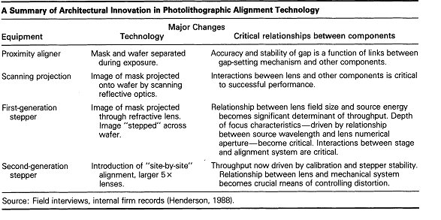
Photolithography
The process that transfers shapes from a template (photomask) onto a surface (silicon wafer) using light
Used in micro manufacturing applications – in digital device such as computers, phones
Kasper's failure to understand the challenge posed by the proximity aligner is especially puzzling given its established position in the market and its depth of experience in photoli-thography.

Slide 11
Discussion and Future Research
Assume that organizations are boundedly rational >> explore ways in which firm’s history and culture affect formulation of architectural and component knowledge
Assume that architectural knowledge embedded in routines and channels becomes inert and hard to change. >> explore the extent to which this can be avoided
An architectural innovation’s effect depends in a direct way on the nature of organizational learning >> what drives effective learning about new architectures and how learning about components may be related to it?
The effect of technology on competitive strategy

Slide 12
Discussion Question
How do we explain the fall of incumbents in the service industry – who usually does not have a product-based architecture, and so, ideally, would have more attention channeled towards identifying architectural innovation among their competitors?
“It ain’t what you don’t know that gets you into trouble.
It’s what you know for sure that just ain’t so.” *
* Misattributed to Mark Twain (a different version was originally given by Leo Tolstoy, 1897)

